Slide 1



DIRECT-TO-EMPLOYER PLAN
WASHINGTON REGIONAL MEDICAL SYSTEM

Slide 2

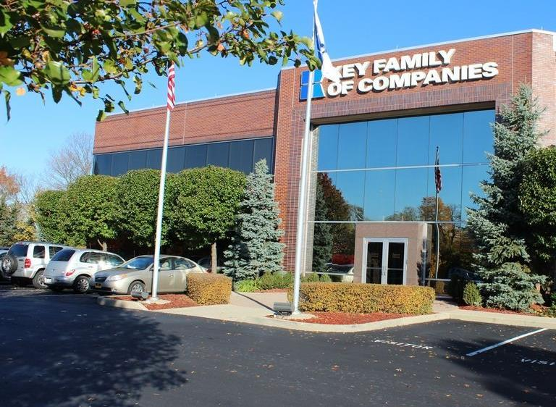

Founded in 1979 and headquartered in Indianapolis, IN​
Full-service TPA specializing in the administration of self-funded health plans and population health management​
One of the country’s largest independently-owned TPAs
The Key Family is a commonly-held group of benefits related organizations with:​
  3,000+ corporate clients​
  3.0 million members under management​
  700 Employees
Exclusive Relationships
We know The Market – Agents, Networks, and MGAs

Slide 3

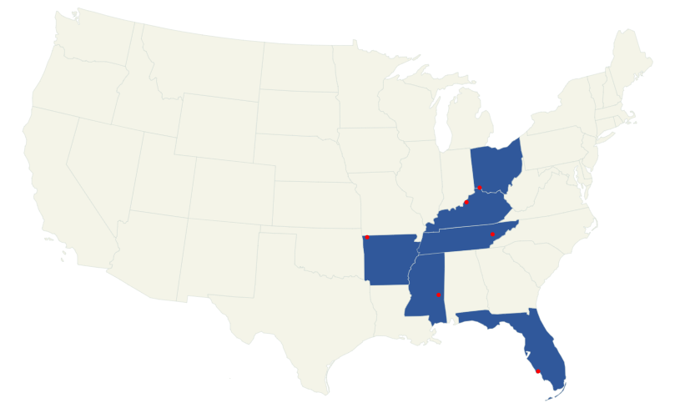
Market Leader in Private Labeled DTE Plans
Louisville, KY
OneHealth Plan
Cincinnati, OH
TCH Optimal
Bentonville, AR
Northwest Health Plan
Knoxville, TN
East Tennessee Health Plan
Meridian, MS
Affinity Health Plan
Fort Myers, FL
Lee Health Care Partners

Slide 4

DTE Keys to Success for Washington Regional Medical System
1
2
DTE Plan Sells
DTE plans only work when the network is built around a strong brand with good access and competitive costs.
Washington Regional Medical System is the quality and access leader in the Benton, Carroll, Madison, Newton, and Washington Counties.
Estimates for Margin and Steerage Hold
KBA models high, medium and low estimates for net income based on (1) estimates of commercial margin and (2) the within-DTE-network steerage rate.
Profit growth will hold if these assumptions accurately play out as expected for Washington Regional Medical System.

Slide 5
Every $1 of Care
Government Pay
Commercial Pay
Results in
~$0.48 of loss
Generates
~$0.21 of profit
See slide 24 for more details on the calculation of commercial and government-pay net income.

Slide 6

Direct-to-Employer Strategy:
Powerful Employer Value
Reduced medical spend through lower unit costs and better integrated care
“At the table” with Washington Regional Medical System
Aligned financial incentives
Complete transparency for unlimited visibility into health benefit plan expenses and cost drivers
Aggressive stop-loss premiums and policy terms
Increased employee satisfaction
Improved cash flow & stabilization of future medical cost trend

Slide 7
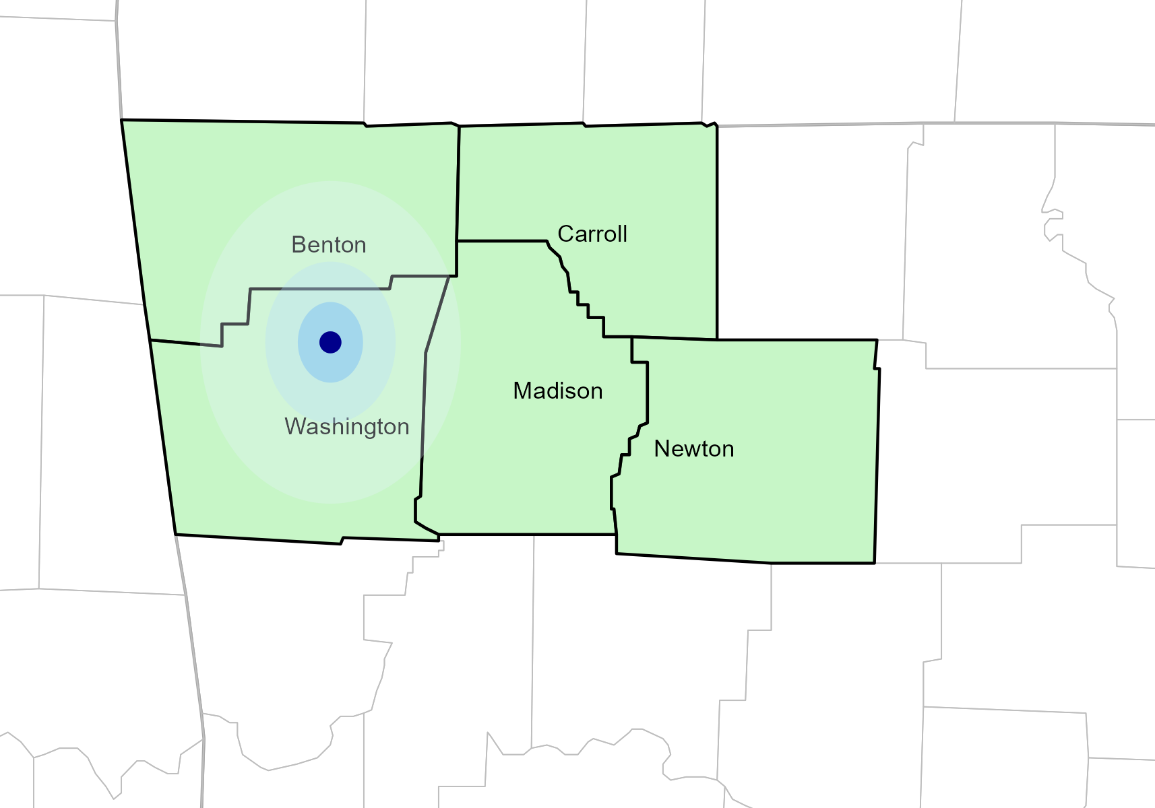
Significant Opportunity for Plan Growth
Researched for Washington, Benton, Carroll, Madison, and Newton Counties
Target Market
500+ Employers 100,000+ Employees 180,000+ Members
 | Employer Size Group (# of Employees)
Commercial Employers With Headquarters | 50-100 | 101-200 | 201-400 | 401-1,000 | 1,001-3,000 | 3,000+
In Catchment Area | 280 | 127 | 81 | 38 | 15 | 11
Total Employees at Employers | 50-100 | 101-200 | 201-400 | 401-1,000 | 1,001-3,000 | 3,000+
Headquartered in Catchment Area | 21,000 | 19,050 | 24,300 | 26,600 | 30,000 | 2M+
Total Members with Employers | 50-100 | 101-200 | 201-400 | 401-1,000 | 1,001-3,000 | 3,000+
Headquartered in Catchment Area | 37,800 | 34,290 | 43,740 | 47,880 | 54,000 | 4M+

Slide 8
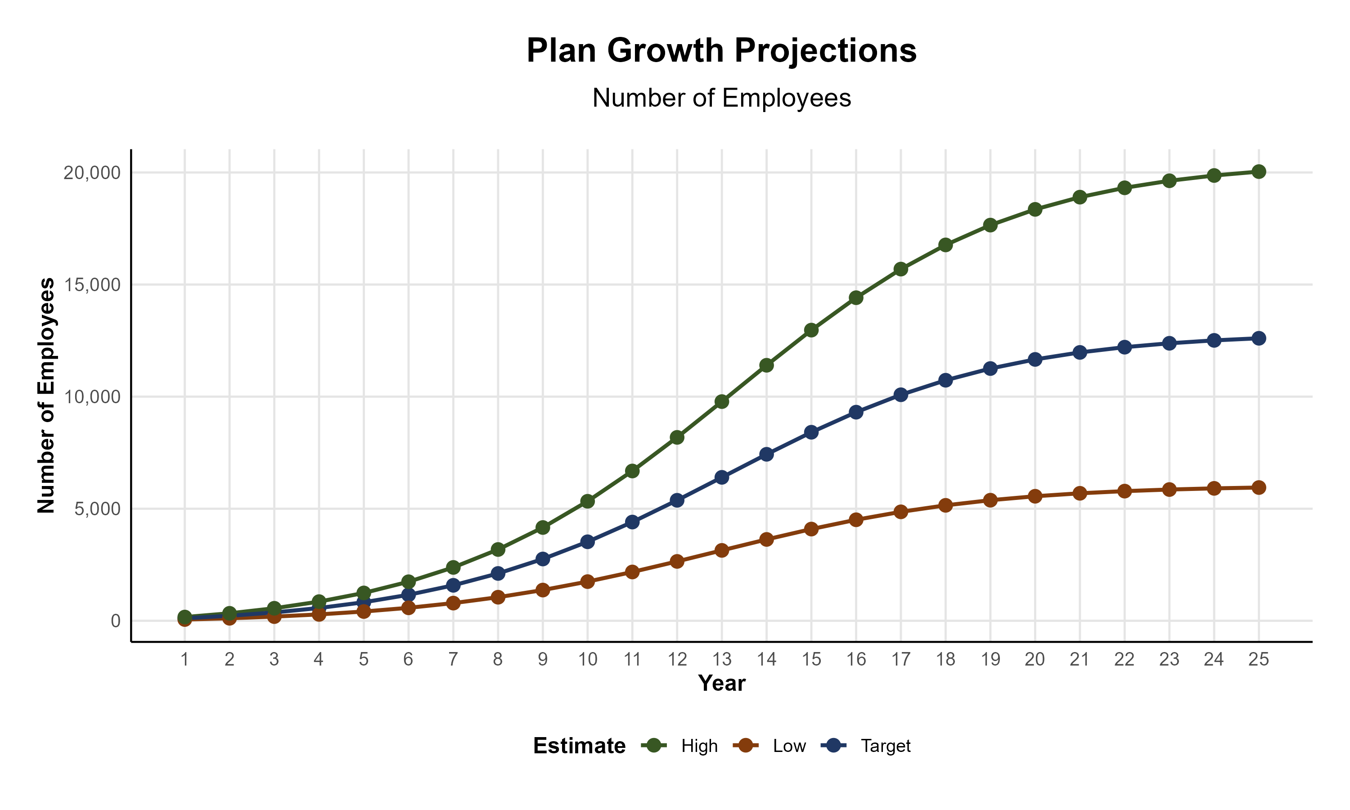
Plan Potential Growth Paths
Self Funded
167K
PLAN GROWTH POTENTIAL
281K
Insured
Working Age
412K
Population
698K
Estimates include Benton, Carroll, Madison, Newton, and Washington Counties

Slide 9

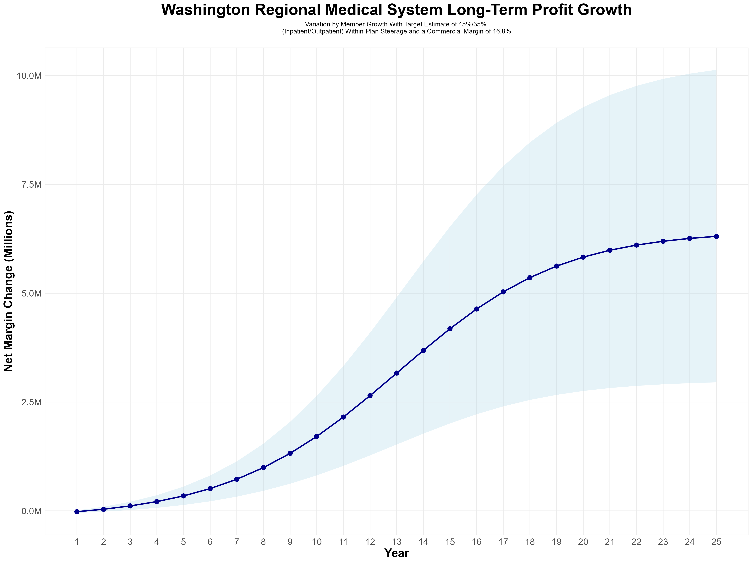
Growing Powerful, Lasting Profitability
Early Stage
Graining Name Recognition, Early Growth
New Revenue:
New Profit:
$2.57M
$0.37M
Growth Stage
Strong Reputation, Strong Growth
New Revenue:
New Profit:
$17.62M
$2.94M
Mature Stage
High Profitability, Market Saturation
New Revenue:
New Profit:
$34.67M
$5.86M

Slide 10
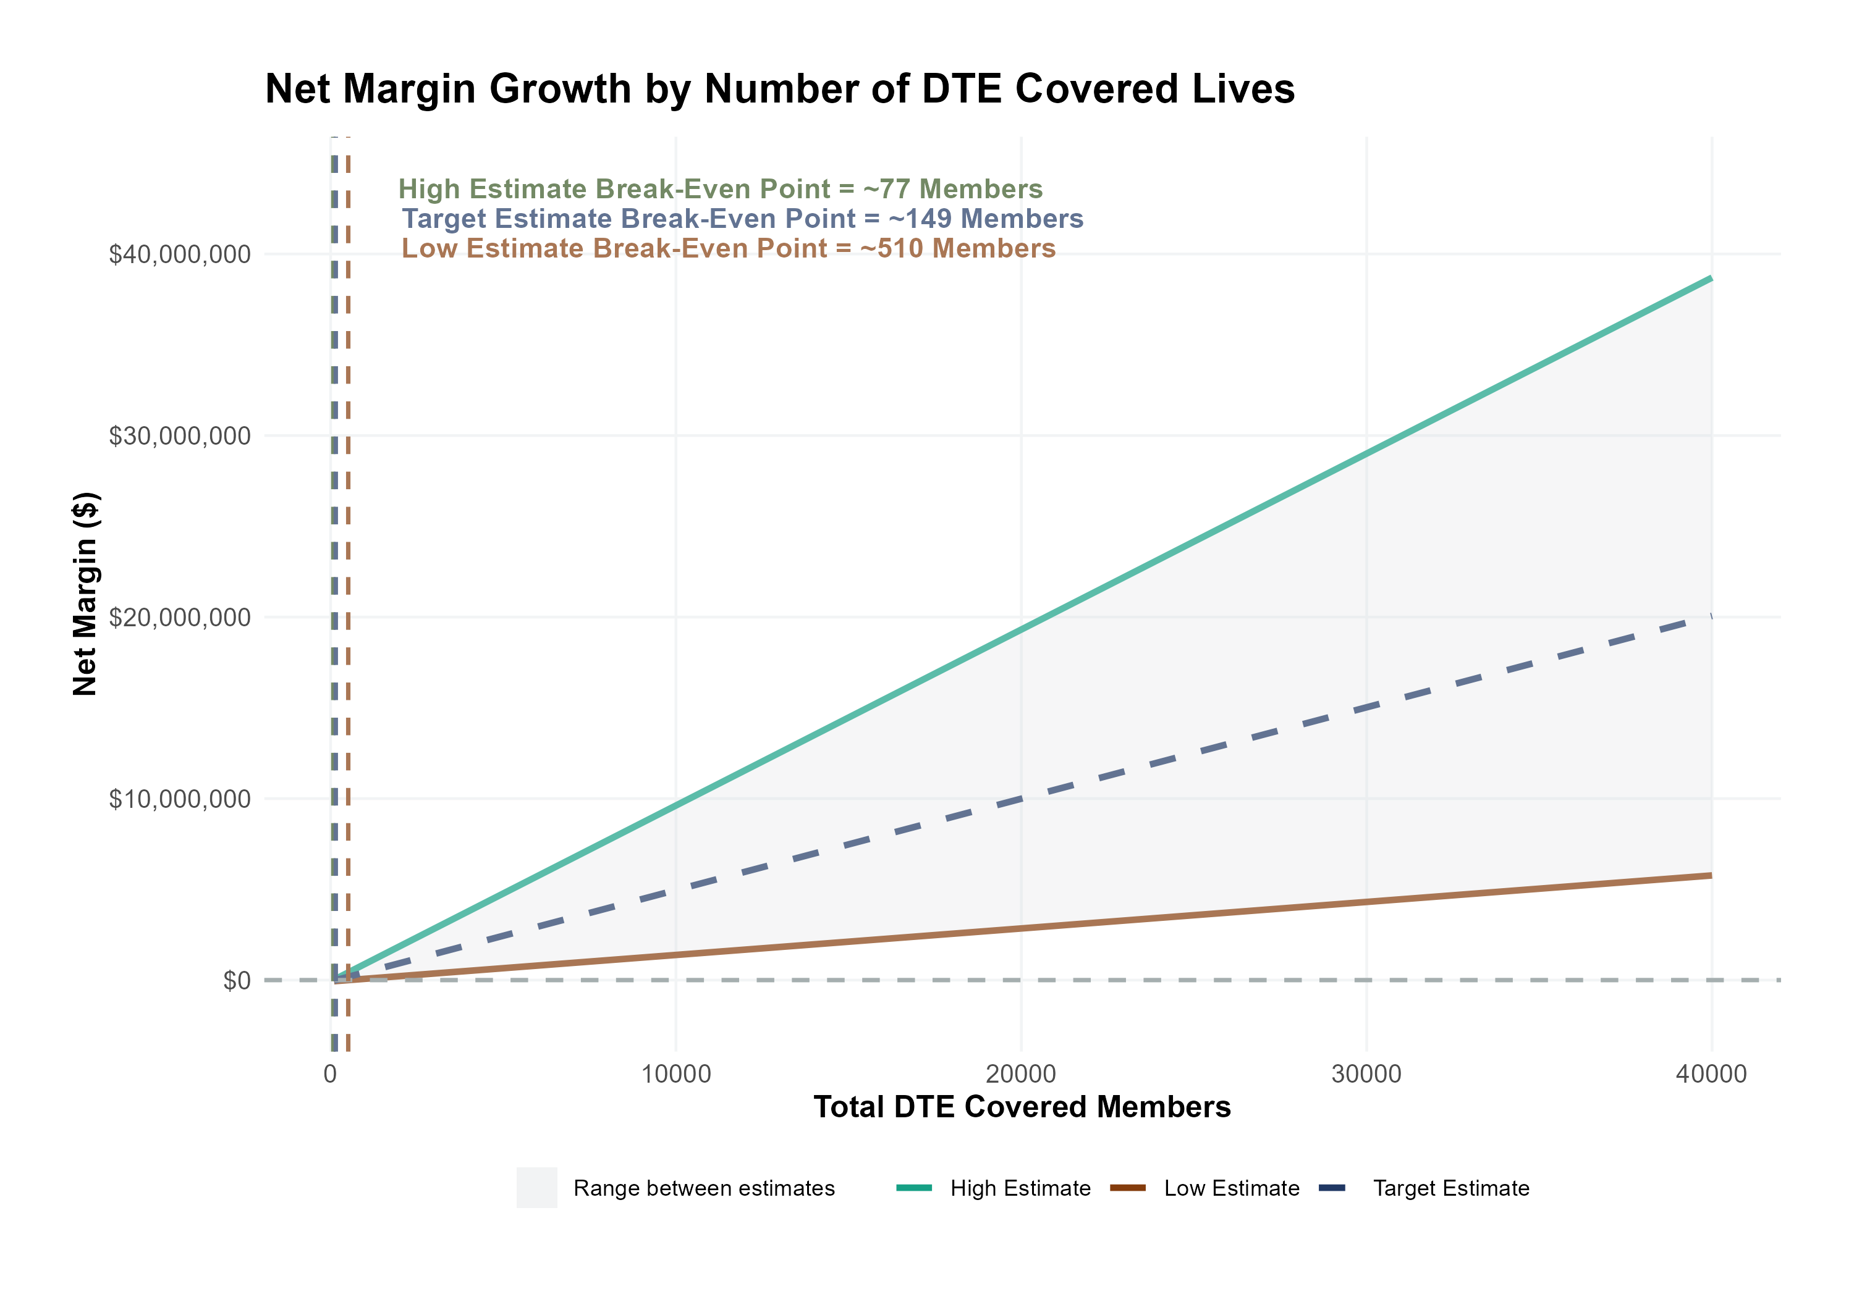
Estimated Financial Returns and Assumptions
Patient Steerage Assumptions
KBA currently estimates that Washington Regional Medical System has 29% inpatient market share, and 10% outpatient market compared to hospitals/clinics in the Washington, Benton, Carroll, Madison, and Newton Counties. We expect the percent of within-DTE patients choosing Washington Regional to be (inpatient/outpatient):
SINGLE-YEAR PROJECTION
Low
Target
High
25%/35%
35%/45%
45%/55%
Commercial Margin Assumptions
KBA estimates DTE margins to be similar to the margin of other commercial plans (prices are lower but billing costs and self-payments are higher). We model DTE commercial margin as on target, below and above other commercial plans.
Low
Target
High
5% Below
Same
5% Above

Slide 11
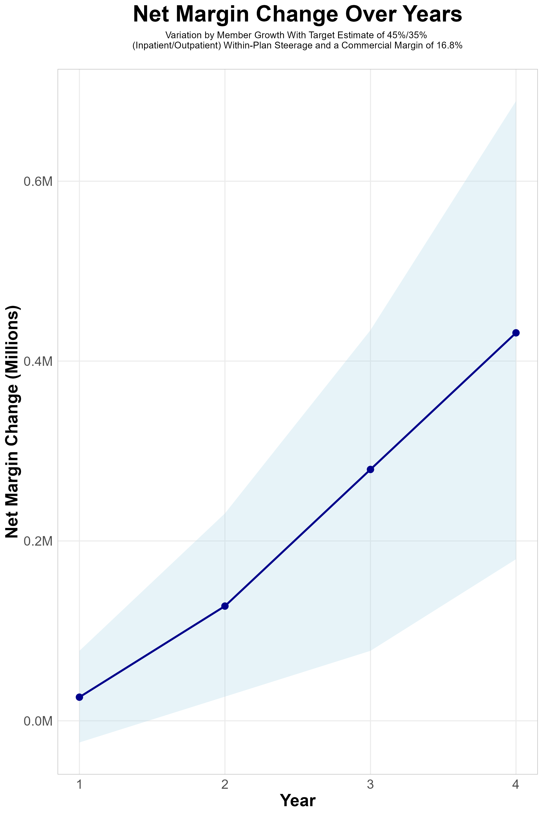
FOUR-YEAR PROJECTIONS
Target Member Growth | Target Member Growth | Target Member Growth | Target Member Growth | Target Member Growth
Metric | Year 1 | Year 2 | Year 3 | Year 4
Number of Members | 200 | 400 | 700 | 1,000
Incremental Margin | 100.7K | 201.4K | 352.4K | 503.4K
Network Access Fee | 1.2K | 2.4K | 4.2K | 6.0K
Implementation Fee (Waved) | 0.0K | 0.0K | 0.0K | 0.0K
Sales and Marketing Costs | -75.0K | -75.0K | -75.0K | -75.0K
Net Margin Change | 26.3K | 127.6K | 279.5K | 431.4K
High Member Growth | High Member Growth | High Member Growth | High Member Growth | High Member Growth
Metric | Year 1 | Year 2 | Year 3 | Year 4
Number of Members | 300 | 600 | 1,000 | 1,500
Incremental Margin | 151.0K | 302.1K | 503.4K | 755.1K
Network Access Fee | 1.8K | 3.6K | 6.0K | 9.0K
Implementation Fee (Waved) | 0.0K | 0.0K | 0.0K | 0.0K
Sales and Marketing Costs | -75.0K | -75.0K | -75.0K | -75.0K
Net Margin Change | 77.8K | 230.7K | 434.4K | 689.1K
Low Member Growth | Low Member Growth | Low Member Growth | Low Member Growth | Low Member Growth
Metric | Year 1 | Year 2 | Year 3 | Year 4
Number of Members | 100 | 200 | 300 | 500
Incremental Margin | 50.3K | 100.7K | 151.0K | 251.7K
Network Access Fee | 0.6K | 1.2K | 1.8K | 3.0K
Implementation Fee (Waved) | 0.0K | 0.0K | 0.0K | 0.0K
Sales and Marketing Costs | -75.0K | -75.0K | -75.0K | -75.0K
Net Margin Change | -24.1K | 26.9K | 77.8K | 179.7K

Slide 12
Direct-to-Employer Strategy:
Only Available to Premier Health Systems
STRONG Brand Quality
EXTENSIVE Patient Access
AFFORDABLE Value Pricing
EXCELLENT Care Quality

Slide 13
Washington Regional Medical System NETWORK
Out of Network
Friends & Family (Contracted)
Wrap Network (Rented)
Washington Regional Medical System’s Network
  The medical providers in your direct control or part of Washington Regional Medical System’s integrated delivery system
  Potential risk sharing arrangements (e.g. employer stop-loss participation)
Friends & Family Providers – TIER 1
  Access through direct contracts at the discretion of Washington Regional Medical System
WRAP NETWORK
  Medical services from national PPO networks for members that travel, tertiary and specialty services you do not provide, and employees residing outside your direct catchment area
  OUT-OF-NETWORK
  Non-contracted medical providers

Slide 14
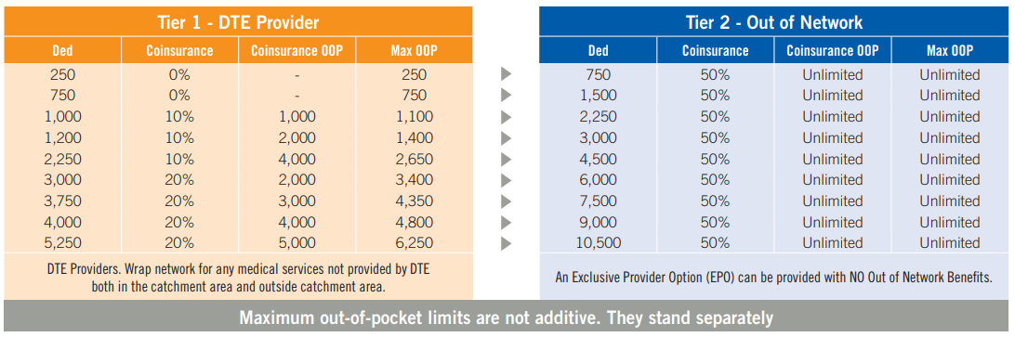
BENEFIT PLAN DESIGNS THAT OPTIMIZE STEERAGE TO WASHINGTON REGIONAL MEDICAL SYSTEM
Exclusive Provider Organization (EPO) Plan Design Structure

Slide 15
SINGLE YEAR SUMMARY
DTE Covered Members Financial Analysis | DTE Covered Members Financial Analysis | DTE Covered Members Financial Analysis | DTE Covered Members Financial Analysis | DTE Covered Members Financial Analysis | DTE Covered Members Financial Analysis | DTE Covered Members Financial Analysis | DTE Covered Members Financial Analysis
Target Estimate of 45%/35% (Inpatient/Outpatient) Within-Plan Steerage and a Commercial Margin of 16.8% (Conservatory Modeled at 80% of Observed Margin) | Target Estimate of 45%/35% (Inpatient/Outpatient) Within-Plan Steerage and a Commercial Margin of 16.8%. | Target Estimate of 45%/35% (Inpatient/Outpatient) Within-Plan Steerage and a Commercial Margin of 16.8%. | Target Estimate of 45%/35% (Inpatient/Outpatient) Within-Plan Steerage and a Commercial Margin of 16.8%. | Target Estimate of 45%/35% (Inpatient/Outpatient) Within-Plan Steerage and a Commercial Margin of 16.8%. | Target Estimate of 45%/35% (Inpatient/Outpatient) Within-Plan Steerage and a Commercial Margin of 16.8%. | Target Estimate of 45%/35% (Inpatient/Outpatient) Within-Plan Steerage and a Commercial Margin of 16.8%. | Target Estimate of 45%/35% (Inpatient/Outpatient) Within-Plan Steerage and a Commercial Margin of 16.8%.
DTE Members | Pre-DTE Revenue | Pre-DTE Margin | DTE Revenue | DTE Incr. Revenue | DTE Total Margin | DTE Incr. Margin | Net Margin Less DTE Fees
100 | $ 163K | $ 27K | $ 459K | $ 296K | $ 77K | $ 50K | $ -25K
500 | $ 813K | $ 137K | $ 2,294K | $ 1,480K | $ 385K | $ 249K | $ 177K
1,000 | $ 1,626K | $ 273K | $ 4,587K | $ 2,961K | $ 771K | $ 497K | $ 428K
2,500 | $ 4,066K | $ 683K | $11,468K | $ 7,402K | $ 1,927K | $1,244K | $1,184K
10,000 | $16,263K | $2,732K | $45,872K | $29,609K | $ 7,706K | $4,974K | $4,959K
20,000 | $32,525K | $5,464K | $91,744K | $59,218K | $15,413K | $9,949K | $9,994K
NOTE: Please see detailed financial analysis and assumptions used starting on page 23.
Financial projections do not include 340B contribution margin, which could represent $136 PMPM by optimizing 340B through Rx plan design, Washington Regional Medical System’s approved site(s) with network integration, and development of Washington Regional Medical System’s proprietary PBM program.

Slide 16

the missing piece to population health success
Patient engagement is the failure point of population health efforts. Direct employer participation and Washington Regional Medical System’s clinical leadership is key to driving patient engagement.
KBA’s DTE strategy positions Washington Regional Medical System to grow commercial market share by reducing per-employee plan costs even further at a time when employers are desperate for a path to better value.
Washington Regional Medical System can demonstrate greater completion rates for Standards of Care for the Chronically Ill, driving better care & cost outcomes.
Adding Washington Regional Medical System’s managed care processes to KBA’s patented care management programs will turbocharge results – Positioning Washington Regional Medical System as a transformational population health leader.
Washington Regional Medical System CAN PROMOTE THESE RESULTS FROM DAY ONE

Slide 17

Transparent PBM Integration
Support of Washington Regional Medical System’s retail pharmacy(s)
Optimize Washington Regional Medical System’s 340B drug pricing program
Allows Washington Regional Medical System to create its own PBM program if desired
Custom telephone number with personalized scripting and separate call tracking & reporting
Fully customizable member welcome booklet & materials
White labeled formulary document and marketing materials
CUSTOM CLIENT SUPPORT:
Specialized call center capabilities
Fully customizable plan designs
Operational access to the platform
Customized process and functions to promote DTE strategy
CLINICAL FLEXIBILITY:
Full portfolio of custom formulary offerings – with optimized formulary shield
Clinical programs that drive towards overall DTE strategy
Options for additional drug savings by driving members to lower cost alternatives
Flexibility to customize or layer on utilization management programs

Slide 18
STOP-LOSS INSURANCE
Tokio Marine
Nationwide
Berkshire Hathaway
Sun Life
Liberty Mutual
Granular (Google)
Companion Life
Crum & Forster
American Fidelity
RGA
KBA has over 20 stop-loss underwriters and carriers that we work with on core employer sponsored plans and DTE health plans;
KBA performs a comprehensive analysis of each stop-loss partner to approve them for our business;
KBA provides comprehensive pricing and medical service analysis for each DTE health plan to ensure proper pricing;
KBA is also evaluated by the stop-loss markets to be an approved claims payer for them;
KBA provides the administration required of the stop-loss markets:
  Bordereau Reporting;
  Claim Reporting and Reconciliation;
  Evaluation of Networks;
  Care Management;
  Initial Underwriting;
  Negotiation of rates and terms; and
  Plan Design Actuarial

Slide 19

DTE
PROGRAM MARKETING
& SALES
    KBA WORKS WITH YOU TO MANAGE & SELL:
  Branding & Messaging
  Direct & Brokerage Sales Distribution – Focused Sales Representative
  Brochures, Web Site, Media, etc.
  Stop-Loss/Level Funded Down to 20 EE Lives
  Sell Through Established Brokers in Your Service Area

Slide 20

Complete Sales Distribution System
BROKER DEVELOPMENT
Identification of Key Distribution Agents
Training and Development
DIRECT SALES
Identification of Key Targets
Working with Washington Regional on Specific Employers
SALES ADMINISTRATION
Quote System
Quote Evaluation
Compensation
Meet and Greet
Sales Process
Closing
Stop Loss Negotiations
Reporting & Analysis
Proposal Development

Slide 21



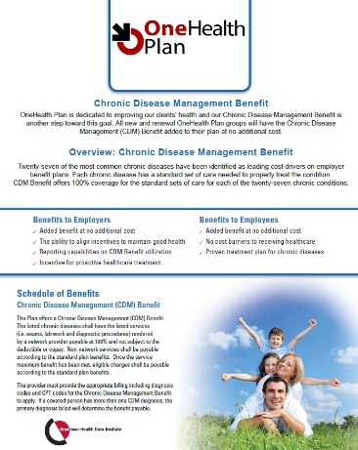
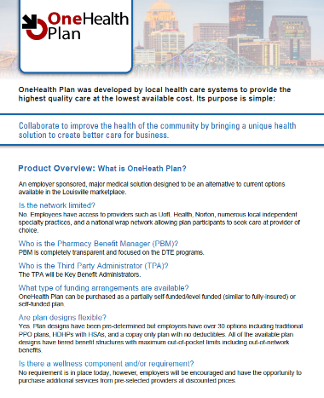

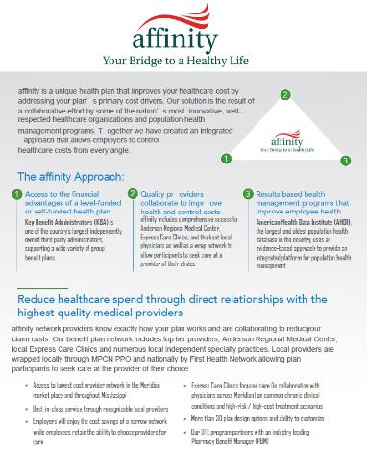
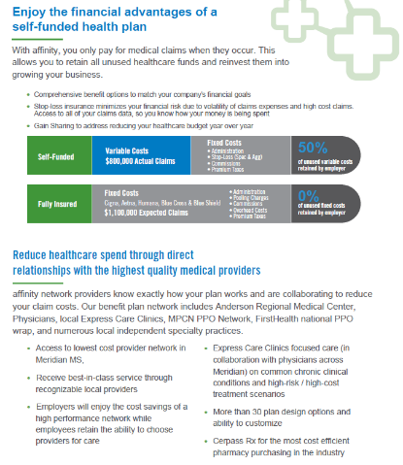
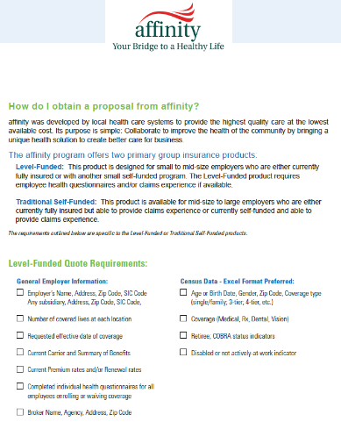
Complete Marketing System
Customized Branding and Messaging
Customized Brochures
Customized Web Site
Targeted Employer Outreach
Sales System (Social Media, Email, Text, etc.)

Slide 22

FINANCIAL PROJECTIONS & ASSUMPTIONS:

Slide 23
Estimation of Washington Regional Medical System’s 2022 Payer Mix
Payer Group | Total Inpatient Days | Revenue | Payer Mix
All Washington Regional Medical System | 76,535 | $392,062K | 100%
Medicare | 20,455 | $81,125K | 27%
Medicaid | 6,323 | $23,385K | 8%
Other Government Pay | 3,777
No-Pay, Charity Care | 3,229 | ($17,266K) | 4%
Commercial/Self Pay | 42,751 | $286,583K | 56%
Estimating Payer Mix
Medicare, Medicaid, and other government payer mixes are estimated as the percentage of inpatient days for each group divided by total inpatient days.
No-pay and charity care is estimated as the percentage of no-pay/charity care compared to total overall revenue.
Commercial/self pay is assumed to be the rest of the total payer mix share.
Estimating Total Inpatient Days
Total inpatient days for ‘No Pay’ and ‘Commercial’ are estimated to be the payer mix estimates for “No Pay, Charity Care” and “Commercial/Self Pay” multiplied by the total number of inpatient days.
Values in blue are taken from the 2021 Medicare Provider Cost Report (https://data.cms.gov/provider-compliance/cost-report/hospital-provider-cost-report/data)
Values in yellow are taken from Definitive Healthcare data.
Total Medicare patient revenue is reported by CMS in the Medicare Provider Analysis and Review Report (MedPAR)
In other analysis, the outpatient payer mix is assumed to mirror the inpatient payer mix.

Slide 24
Estimation of Margin for Commercial vs. Government Pay
The RAND data for Washington Regional Medical System estimates commercial insurance reimbursements at 188% of Medicare Rates
Estimating Commercial Margin
(Calculated through counterfactual of assuming all CMS/Government pay was paying at commercial rates)
Estimating Gov-Pay Margin
(Calculated through counterfactual of assuming all commercial pay was paying at Medicare rate)
Commercial Revenue | $286,583K
Gov-pay revenue at 188% current rate | $196,479K
Total Revenue | $483,062K
Total Costs | $379,944K
Net Income | $103,118K
 | 21%
Commercial Revenue Divided by 188% | $152,438K
Gov-pay revenue | $104,510K
Total Revenue | $256,948K
Total Costs | $379,944K
Net Income | $ -122,996K
 | -48%

Slide 25
Modeling Prices and Commercial Margins
KBA recommends targeting KBA DTE prices 10% below commercial rates (resulting in a roughly 10 percentage-point drop in DTE profit).
To compensate for this lower margin, KBA provides the following margin improvements:
  Far friendlier billing practices than commercial insurance.
  Patient cards allow patients a no-interest payment option for tier-1 patient-responsibility payments. This card also improves patient steerage towards Washington Regional.

Slide 26
Estimating Market Share
Hospital Name | Number of Beds | Inpatient Total Charges | Outpatient Total Charges | Inpatient Percent of Market Total | Outpatient Percent of Market Total (Assuming 49.1% of Physicians Employed by Hospitals)
Washington Regional Medical Center | 377 | $1,007,944.9K | $ 832,722.0K | 29% | 10%
Siloam Springs Regional Hospital | 64 | $ 116,837.2K | $ 374,691.9K | 3% | 4%
Mercy Hospital Northwest Arkansas (FKA Mercy Medical Center) | 236 | $ 716,612.8K | $ 904,575.0K | 21% | 11%
Northwest Medical Center - Springdale | 414 | $1,318,668.2K | $1,214,941.1K | 38% | 14%
Northwest Health Physicians Specialty Hospital | 20 | $ 85,807.2K | $ 88,377.3K | 2% | 1%
Mercy Hospital Berryville (FKA St Johns Hospital Berryville) | 25 | $ 6,194.7K | $ 56,695.5K | 0% | 1%
Ozarks Community Hospital of Gravette (AKA Ozarks Community Health System) | 25 | $ 26,195.0K | $ 110,684.7K | 1% | 1%
Arkansas Childrens Northwest | 24 | $ 42,439.4K | $ 184,040.2K | 1% | 2%
Freeman Neosho Hospital | 21 | $ 19,337.2K | $ 115,077.4K | 1% | 1%
Ascension St John Jane Phillips Medical Center (FKA Jane Phillips Memorial Medical Center) | 81 | $ 131,666.6K | $ 324,545.6K | 4% | 4%
For outpatient market share, it is estimated that only 49.1% of local physicians are employed by area hospitals (Research from the Physician Advocacy Institute: https://www.physiciansadvocacyinstitute.org/Portals/0/assets/docs/PAI-Research/PAI-Avalere%20Physician%20Employment%20Trends%20Study%202019-2023%20Final.pdf?ver=uGHF46u1GSeZgYXMKFyYvw%3d%3d)

Slide 27
Hospital Metrics | Hospital Metrics
Metric | Washington Regional Medical Center
Total Hospital Days | 76,535
Total Medicare Days | 20,455
Total Medicaid Days | 6,323
Total Other Government Payer Days | 3,777
Total Inpatient Patient Revenue | $214,692.3K
Total Outpatient Patient Revenue | $177,369.8K
Total Medicare Revenue | $81,125.18K
Estimated Medicaid and Other Government-Pay Revenue | $23,384.81K
Estimated Commercial Revenue | $286,583.3K
Total Uncompensated Care | $17,266.98K
Estimated Inpatient Costs | $208,056.3K
Estimated Outpatient Costs | $171,887.4K
Total Operating Expenses | $379,943.8K
Net Income | $11,149.55K
Estimated Payer Mix Percent Medicare | 26.7%
Estimated Payer Mix Percent Medicaid | 8.3%
Estimated Payer Mix Percent Other Government-Pay | 4.9%
Payer Mix Percent No Pay | 4.2%
Estimated Payer Mix Percent Commercial | 55.9%
Estimated Commercial Profit Margin | 21.3%
1. Most data is taken from the CMS provider cost report | 1. Most data is taken from the CMS provider cost report
2. Medicare costs are taken from the Medicare Provider Analysis and Review (MedPAR) | 2. Medicare costs are taken from the Medicare Provider Analysis and Review (MedPAR)
3. Data with 'Estimated' in the title are derived from other data points. | 3. Data with 'Estimated' in the title are derived from other data points.
4. Market Share estimates based on total patient revenues with area hospitals. Ambulatory market share based on regional estimates of the percentage of local physicians employed by area hospitals. See Physician Advocacy Institute | 4. Market Share estimates based on total patient revenues with area hospitals. Ambulatory market share based on regional estimates of the percentage of local physicians employed by area hospitals. See Physician Advocacy Institute

Slide 28
Estimating PMPY Spend (KBA Data)
Category | Standardized Allowed Charges | Standardized Paid Charges | Member Years | Nationwide Average of Paid Claims | Adjusted to Benton, Carroll, Madison, Newton, and Washington Counties Rates
Inpatient | $ 561,766,609 | $ 358,815,229 | 105,492 | $ 3,401 | $ 2959
OutPatient | $ 1,223,989,466 | $ 652,333,702 |  | $ 6,184 | $ 5379
Professional | $ 549,353,224 | $ 304,634,120 |  | $ 2,888 | $ 2512
KBA utilizes its data warehouse with greater than $3B in yearly adjudicated charges to estimate PMPY spend by inpatient, outpatient and professional charges. Pharmacy and non-health-system charges are excluded.
Using the Milliman area adjustment factors by zip code, charges are standardized to local estimates.
These estimated charges are conservative as KBA claims average ~15% below the market average.

Slide 29
Estimating Expected Steerage (KBA Data)
 | DTE Health Plan Tier 1 Utilization – Q1 2024
 | Charges | % | Paid | % | Discount Equivalent
 |  |  |  |  | Charge to Paid
Tier 1 |  | 81.26%
Current DTE Network #1 | $ 17,913,805.69 | 54.82% | $ 6,907,327.88 | 58.63% | -61.44%
Current DTE Network #2 | $ 8,460,570.40 | 78.37% | $ 3,280,571.45 | 77.62% | -61.23%
Current DTE Network #3 | $ 629,748.27 | 72.98% | $ 198,216.95 | 80.64% | -68.52%
Current DTE Network #4 | $ 58,261,069.02 | 96.15% | $ 12,968,046.77 | 93.20% | -77.74%
 | $ 85,265,193.38 |  | $ 23,354,163.05
DTE Steerage Impact on an EPO Plan Structure
KBA is modeling steerage in line with other observed DTE networks.
Tier 1 steerage will be split between Washington Regional and Northwest.

Slide 30
Pre-DTE Cohort of 5,000 Members | Inpatient | Outpatient | Professional | Total
Revenue† | $ 4,295,696 | $ 2,614,655 | $ 1,221,022 | $ 8,131,373
Net Income‡ | $ 721,676.9 | $ 439,262.1 | $ 205,131.7 | $ 1,366,071
† Assuming proportional revenues from market shares of 29% (inpatient) and 10% (outpatient)
‡ Conservatively assuming a commercial margin of 16.8% (80% of the estimated commercial margin)
With DTE | Inpatient | Outpatient | Professional | Total
Revenue⁰ | $ 5,178,540 | $ 12,104,612 | $ 5,652,751 | $ 22,935,904
Net Income* | $ 869,994.7 | $ 2,033,575 | $ 949,662.2 | $ 3,853,232
⁰ Assuming 45%/35% market steerage based on KBA narrow network DTE experience
* Conservatively assuming a commercial margin of 16.8% (80% of observed commercial margin), with a 10 percentage-point reduction to reflect competitive-edge rates and a 10 percentage-point increase to reflect lower billing costs and better patient-responsibility collections because of the plan patient card.
Total Increase in Net Income | $ 2,487,161
Network Access Fee (Revenue) of $1 PMPM | $ 30,000
Total Profit Growth | $ 2,517,161
Minus Implementation Fee (Waved) | $0
Minus Sales and Marketing (Annual – Ongoing) | -$ 75,000
Total | $ 2,442,161

Slide 31
Target Estimate of 45%/35% (Inpatient/Outpatient) Within-Plan Steerage and a Commercial Margin of 16.8% | Target Estimate of 45%/35% (Inpatient/Outpatient) Within-Plan Steerage and a Commercial Margin of 16.8% | Target Estimate of 45%/35% (Inpatient/Outpatient) Within-Plan Steerage and a Commercial Margin of 16.8% | Target Estimate of 45%/35% (Inpatient/Outpatient) Within-Plan Steerage and a Commercial Margin of 16.8% | Target Estimate of 45%/35% (Inpatient/Outpatient) Within-Plan Steerage and a Commercial Margin of 16.8%
All values in thousands of dollars | All values in thousands of dollars | All values in thousands of dollars | All values in thousands of dollars | All values in thousands of dollars
Metric | 500 DTE Covered Lives | 1000 DTE Covered Lives | 5000 DTE Covered Lives | 25000 DTE Covered Lives
Pre-DTE Group Inpatient Revenue | $429.6 | $859.1 | $4,295.7 | $21,478.5
Pre-DTE Group Inpatient Margin | $72.2 | $144.3 | $721.7 | $3,608.4
DTE Group Inpatient Revenue | $517.9 | $1,035.7 | $5,178.5 | $25,892.7
DTE Group Inpatient Margin | $87.0 | $174.0 | $870.0 | $4,350.0
DTE Group Incremental Inpatient Revenue | $88.3 | $176.6 | $882.8 | $4,414.2
DTE Group Incremental Inpatient Margin | $14.8 | $29.7 | $148.3 | $741.6
Pre-DTE Group Outpatient Revenue | $261.5 | $522.9 | $2,614.7 | $13,073.3
Pre-DTE Group Outpatient Margin | $43.9 | $87.9 | $439.3 | $2,196.3
DTE Group Outpatient Revenue | $1,210.5 | $2,420.9 | $12,104.6 | $60,523.1
DTE Group Outpatient Margin | $203.4 | $406.7 | $2,033.6 | $10,167.9
DTE Group Incremental Outpatient Revenue | $949.0 | $1,898.0 | $9,490.0 | $47,449.8
DTE Group Incremental Outpatient Margin | $159.4 | $318.9 | $1,594.3 | $7,971.6
Pre-DTE Group Professional Revenue | $122.1 | $244.2 | $1,221.0 | $6,105.1
Pre-DTE Group Professional Margin | $20.5 | $41.0 | $205.1 | $1,025.7
DTE Group Professional Revenue | $565.3 | $1,130.6 | $5,652.8 | $28,263.8
DTE Group Professional Margin | $95.0 | $189.9 | $949.7 | $4,748.3
DTE Group Incremental Professional Revenue | $443.2 | $886.3 | $4,431.7 | $22,158.6
DTE Group Incremental Professional Margin | $74.5 | $148.9 | $744.5 | $3,722.7
Net Margin Less DTE Fees | $176.7 | $428.4 | $2,442.2 | $12,510.8

Slide 32
Target Estimate of 45%/35% (Inpatient/Outpatient) Within-Plan Steerage and a Commercial Margin of 16.8% | Target Estimate of 45%/35% (Inpatient/Outpatient) Within-Plan Steerage and a Commercial Margin of 16.8% | Target Estimate of 45%/35% (Inpatient/Outpatient) Within-Plan Steerage and a Commercial Margin of 16.8% | Target Estimate of 45%/35% (Inpatient/Outpatient) Within-Plan Steerage and a Commercial Margin of 16.8% | Target Estimate of 45%/35% (Inpatient/Outpatient) Within-Plan Steerage and a Commercial Margin of 16.8%
All values in thousands of dollars | All values in thousands of dollars | All values in thousands of dollars | All values in thousands of dollars | All values in thousands of dollars
Metric | 500 DTE Covered Lives | 1000 DTE Covered Lives | 5000 DTE Covered Lives | 25000 DTE Covered Lives
Pre-DTE Group Total Revenue | $813.1 | $1,626.3 | $8,131.4 | $40,656.9
Pre-DTE Group Total Margin | $136.6 | $273.2 | $1,366.1 | $6,830.4
DTE Group Total Revenue | $2,293.6 | $4,587.2 | $22,935.9 | $114,679.5
DTE Group Incremental Total Revenue | $1,480.5 | $2,960.9 | $14,804.5 | $74,022.7
Incremental Total Revenue by Member | $3.0 | $3.0 | $3.0 | $3.0
DTE Group Total Margin | $385.3 | $770.6 | $3,853.2 | $19,266.2
DTE Group Incremental Total Margin | $248.7 | $497.4 | $2,487.2 | $12,435.8
Wellness Share | $3.0 | $6.0 | $30.0 | $150.0
Implementation Fee (Waved) | $0.0 | $0.0 | $0.0 | $0.0
Sales and Marketing Annual Fee | $75.0 | $75.0 | $75.0 | $75.0
Net Margin Less DTE Fees | $176.7 | $428.4 | $2,442.2 | $12,510.8

Slide 33
High Estimate of 55%/45% (Inpatient/Outpatient) Within-Plan Steerage and a Commercial Margin of 21.8% | High Estimate of 55%/45% (Inpatient/Outpatient) Within-Plan Steerage and a Commercial Margin of 21.8% | High Estimate of 55%/45% (Inpatient/Outpatient) Within-Plan Steerage and a Commercial Margin of 21.8% | High Estimate of 55%/45% (Inpatient/Outpatient) Within-Plan Steerage and a Commercial Margin of 21.8% | High Estimate of 55%/45% (Inpatient/Outpatient) Within-Plan Steerage and a Commercial Margin of 21.8%
All values in thousands of dollars | All values in thousands of dollars | All values in thousands of dollars | All values in thousands of dollars | All values in thousands of dollars
Metric | 500 DTE Covered Lives | 1000 DTE Covered Lives | 5000 DTE Covered Lives | 25000 DTE Covered Lives
Pre-DTE Group Total Revenue | $813.1 | $1,626.3 | $8,131.4 | $40,656.9
Pre-DTE Group Total Margin | $136.6 | $273.2 | $1,366.1 | $6,830.4
DTE Group Total Revenue | $2,836.2 | $5,672.3 | $28,361.6 | $141,807.8
DTE Group Incremental Total Revenue | $2,023.0 | $4,046.0 | $20,230.2 | $101,151.0
DTE Group Total Margin | $618.3 | $1,236.6 | $6,182.8 | $30,914.1
DTE Group Incremental Total Margin | $481.7 | $963.4 | $4,816.8 | $24,083.8
Wellness Share | $3.0 | $6.0 | $30.0 | $150.0
Implementation Fee (Waved) | $0.0 | $0.0 | $0.0 | $0.0
Sales and Marketing Annual Fee | $75.0 | $75.0 | $75.0 | $75.0
Net Margin Less DTE Fees | $409.7 | $894.4 | $4,771.8 | $24,158.8

Slide 34
Low Estimate of 35%/25% (Inpatient/Outpatient) Within-Plan Steerage and a Commercial Margin of 11.8% | Low Estimate of 35%/25% (Inpatient/Outpatient) Within-Plan Steerage and a Commercial Margin of 11.8% | Low Estimate of 35%/25% (Inpatient/Outpatient) Within-Plan Steerage and a Commercial Margin of 11.8% | Low Estimate of 35%/25% (Inpatient/Outpatient) Within-Plan Steerage and a Commercial Margin of 11.8% | Low Estimate of 35%/25% (Inpatient/Outpatient) Within-Plan Steerage and a Commercial Margin of 11.8%
All values in thousands of dollars | All values in thousands of dollars | All values in thousands of dollars | All values in thousands of dollars | All values in thousands of dollars
Metric | 500 DTE Covered Lives | 1000 DTE Covered Lives | 5000 DTE Covered Lives | 25000 DTE Covered Lives
Pre-DTE Group Total Revenue | $813.1 | $1,626.3 | $8,131.4 | $40,656.9
Pre-DTE Group Total Margin | $136.6 | $273.2 | $1,366.1 | $6,830.4
DTE Group Total Revenue | $1,751.0 | $3,502.0 | $17,510.2 | $87,551.2
DTE Group Incremental Total Revenue | $937.9 | $1,875.8 | $9,378.9 | $46,894.3
DTE Group Total Margin | $206.6 | $413.2 | $2,066.2 | $10,331.0
DTE Group Incremental Total Margin | $70.0 | $140.0 | $700.1 | $3,500.7
Wellness Share | $3.0 | $6.0 | $30.0 | $150.0
Implementation Fee (Waved) | $0.0 | $0.0 | $0.0 | $0.0
Sales and Marketing Annual Fee | $75.0 | $75.0 | $75.0 | $75.0
Net Margin Less DTE Fees | $-2.0 | $71.0 | $655.1 | $3,575.7

Slide 35
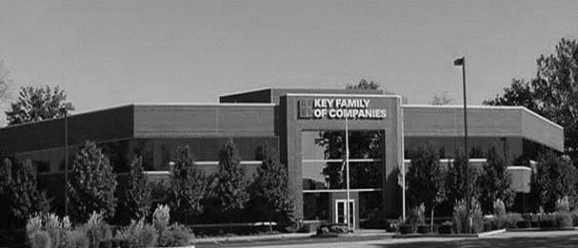



COLLABORATION OF STAKEHOLDERS
Key Benefit Administrators
Employer
Employee
Full TPA Administration
Stop-Loss Administration
True Transparency & Analytics
Population Health Management
Utilization & Case Management
Sales & Marketing
Transparent PBM
Website & Mobile App
Customizable options & plans
Incremental Revenues and Margin
Branding & Messaging
Benefit Plan Integration
Network Steerage
Direct Relationship with Self-Funded Employers
Referral Authorization
Plan Transparency
Direct Access to Members
Reduced Spend
“At The Table” with Washington Regional Medical System
Improved Analytics
Complete Transparency
Lower Stop-Loss
Benefit Plan Stabilization
Healthier Population
Reduced Out of Pocket
Improved Health
Better Coordination & Navigation of Care
Direct Access to the Best Medical Providers
Washington Regional Medical System’s DTE

Slide 36
ROLES & RESPONSIBILITIES
SERVICES & ADMINISTRATIVE SYSTEMS PROVIDED BY:
Washington Regional Medical System | KBA Operations
Tier 1 Provider Network Provider Recruitment – If Necessary Network Pricing & Contract Terms Referral Management Protocols & Approvals Medical Director Oversight Practice Improvement Program using KBA/AHDI Data with Assistance from KBA | Network Evaluation – Actuarial Pricing PPO Wrap & Tertiary Transplant Network, if needed Claims Administration Plan Design Development, Testing, and Administration Employer/Member/Provider Customer Service Customized Member/Provider/Agent/HR Portal Billing, Enrollment (Electronic/Paper), and Premium Management Fulfilment – SPD & Customized ID Cards COBRA/HIPAA Administration Out of Network Negotiations Wrap PPO Repricing Nurse Coaching for Chronically Ill Nurse Triage to Physicians and Facilities Stop-Loss Underwriting, Pricing, and Placement Stop Loss Claims Administration Complex Case Management PBM Administration Interface Reporting Utilization & Gaps in Care Clinically Based Physician Profiling Referrals Chronic Disease Management Employer Health Risk Management Reports Ancillary Administration – Dental, Vision, Weekly Income, 5500, Life, etc. Health Savings Account (HSA), Flexible Spending (FSA), Health Reimbursement Account (HRA) Administration Sales & Marketing Plan Strategy Development: Branding, Brochures, Web Site Distribution System Development Sales Management
KBA Consulting
Program oversight and integration across the enterprise Goal development, agreement and tracking Start-up assessments: market, network, operational and readiness Draft business plan with financial projections Facilitate program communication and engagement with Washington Regional Medical System departments including system c-suite, operations, HR, managed care, marketing, strategy and business development

Slide 37
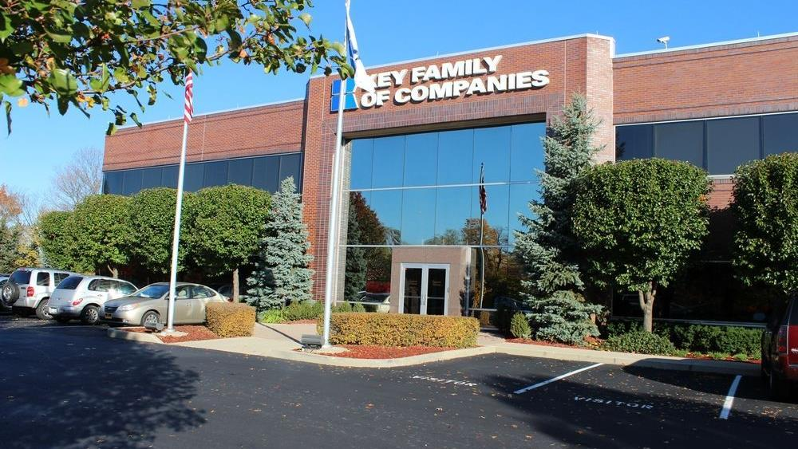




A Partner You Can Trust
OUR OBJECTIVES ARE ALIGNED
WE KNOW THE
MARKET
COMPLETELY TRANSPARENT
WE HAVE THE SOPHISTICATION AND INFRASTRUCTURE TO EFFECTIVELY COMPETE
Derek Moore, Senior Vice President – KBA
845-283-9973 * derek.moore@keybenefit.com

